Slide 1
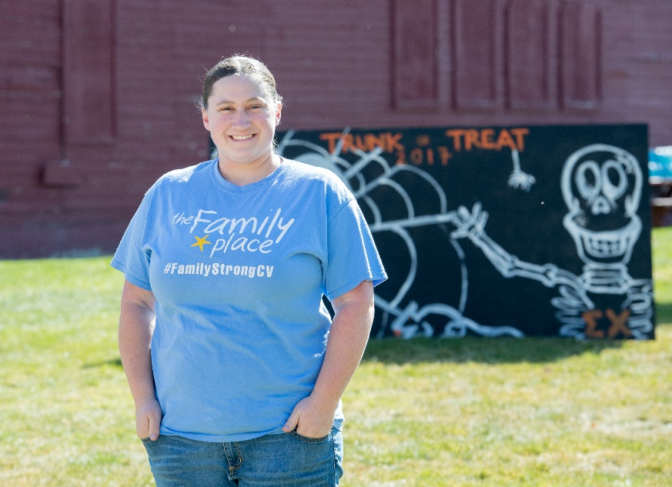
How to Plan a Successful Fundraiser
By: Britney Bird and Ashlee Flitton

Slide 2
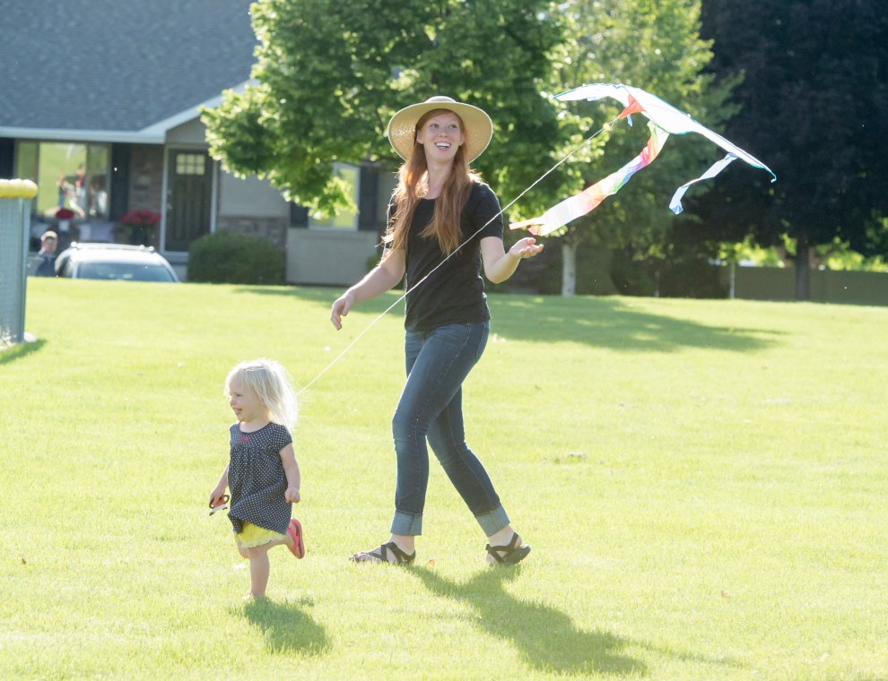
Warm Up- Break into groups
What fundraisers have you heard of in Cache Valley?
What fundraisers did you attend?
What made the difference in you attending the ones you did verse the ones you didn’t?

Slide 3
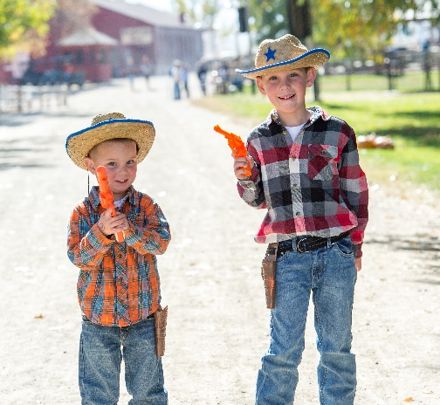
Prepare
What type of Fundraiser are you going to do?
Your audience or demographic- Who are you trying to reach makes one of the biggest impacts of how you move forward with your fundraiser.
https://www.youtube.com/watch?v=LBKry741SVg
2. Your brand and mission
https://www.youtube.com/watch?v=knxgFkEdrUM
3. Your goal - Set ONE goal and have everything you do reflect that goal.
Each Fundraiser can have a different goal even if your overall goal is to raise money!
Examples – Dinner & Auction vs. Fly with The Family Place

Slide 4
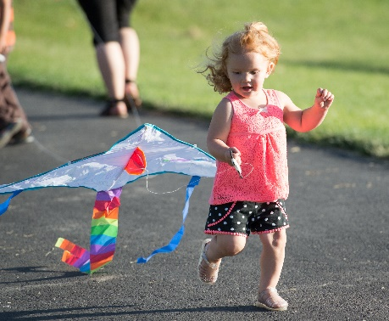
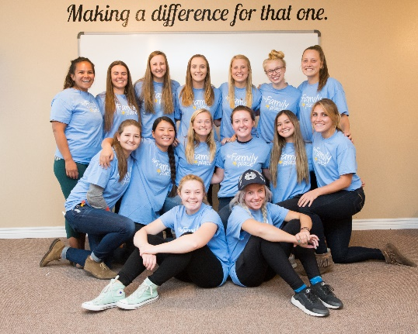
Prepare
4. Your budget- important to spend less than you are going to make
a. BUT- You have to spend money to make money!!
5. Your available time- how early are you starting and how much time can you dedicate to the fundraiser?
6. Your expertise- What are you good at? Do you have interests that will impact your involvement level?
7. Your staff and volunteers- who do you have in your team to help you?
https://www.youtube.com/watch?v=J6Lk2nZb79s

Slide 5
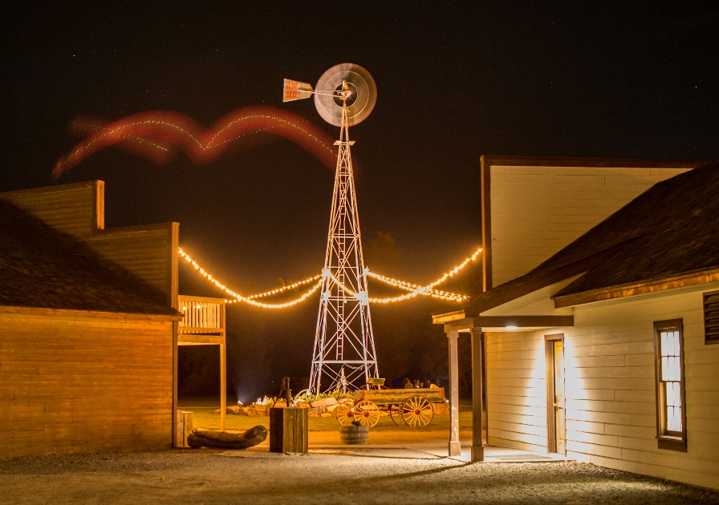
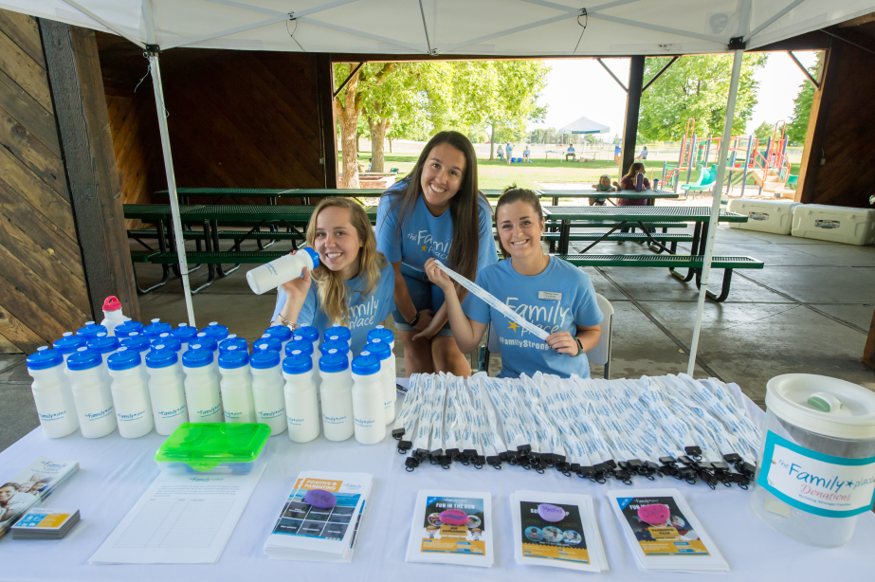
Plan
Marketing
Where are people going to hear about your fundraiser?
i. Radio
ii. Newspaper
iii. Flyers in Businesses
iv. Social Media
v. Word of Mouth

Slide 6
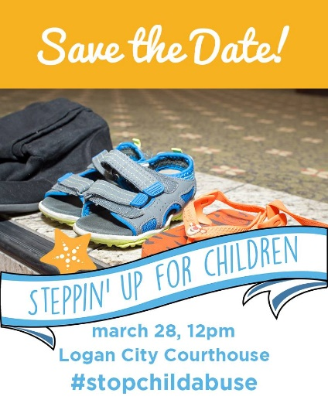
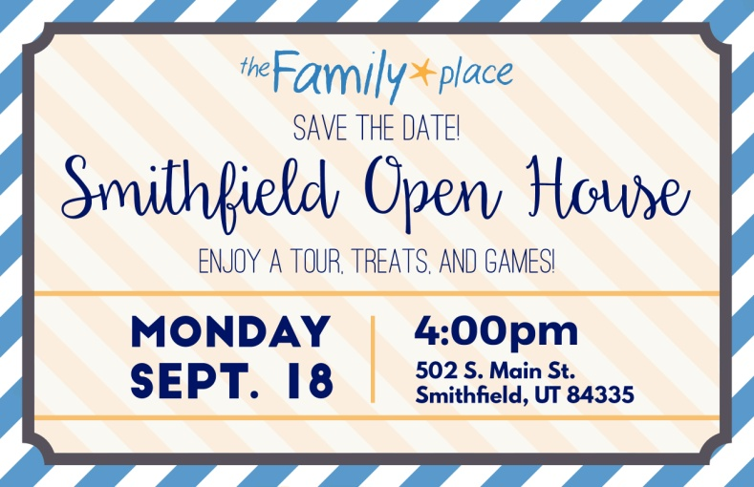
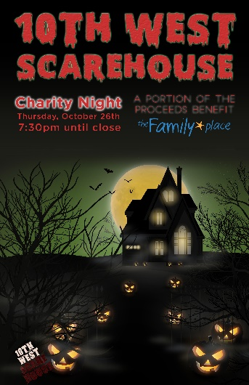
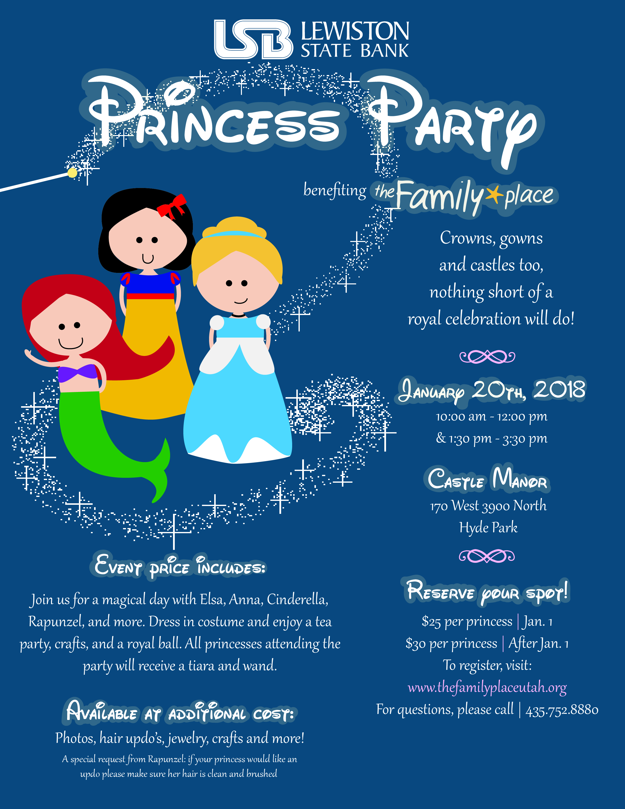
Flyers

Slide 7
Pay attention to the small things! Write everything down/Draw it out
https://www.youtube.com/watch?v=Hx9AAOQ9vE8

Slide 8
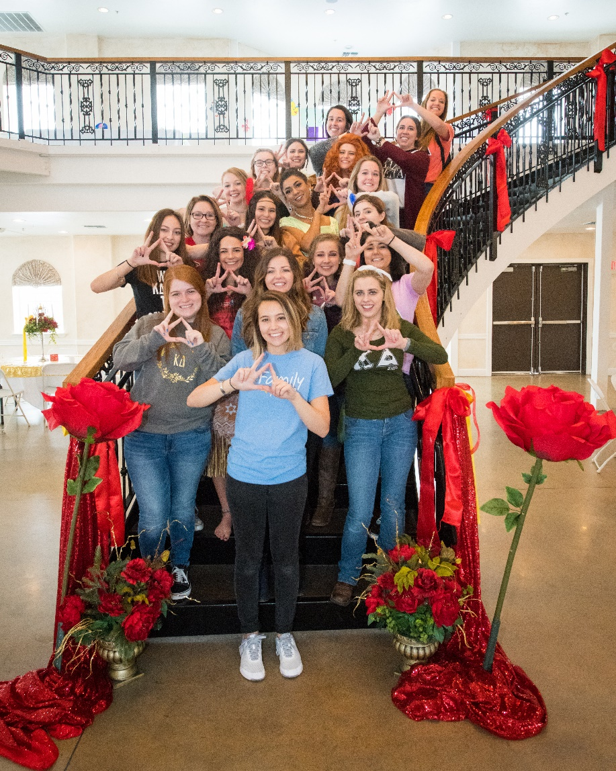
Find Sponsors
https://www.youtube.com/watch?v=ZRA4Pq-iNio

Slide 9
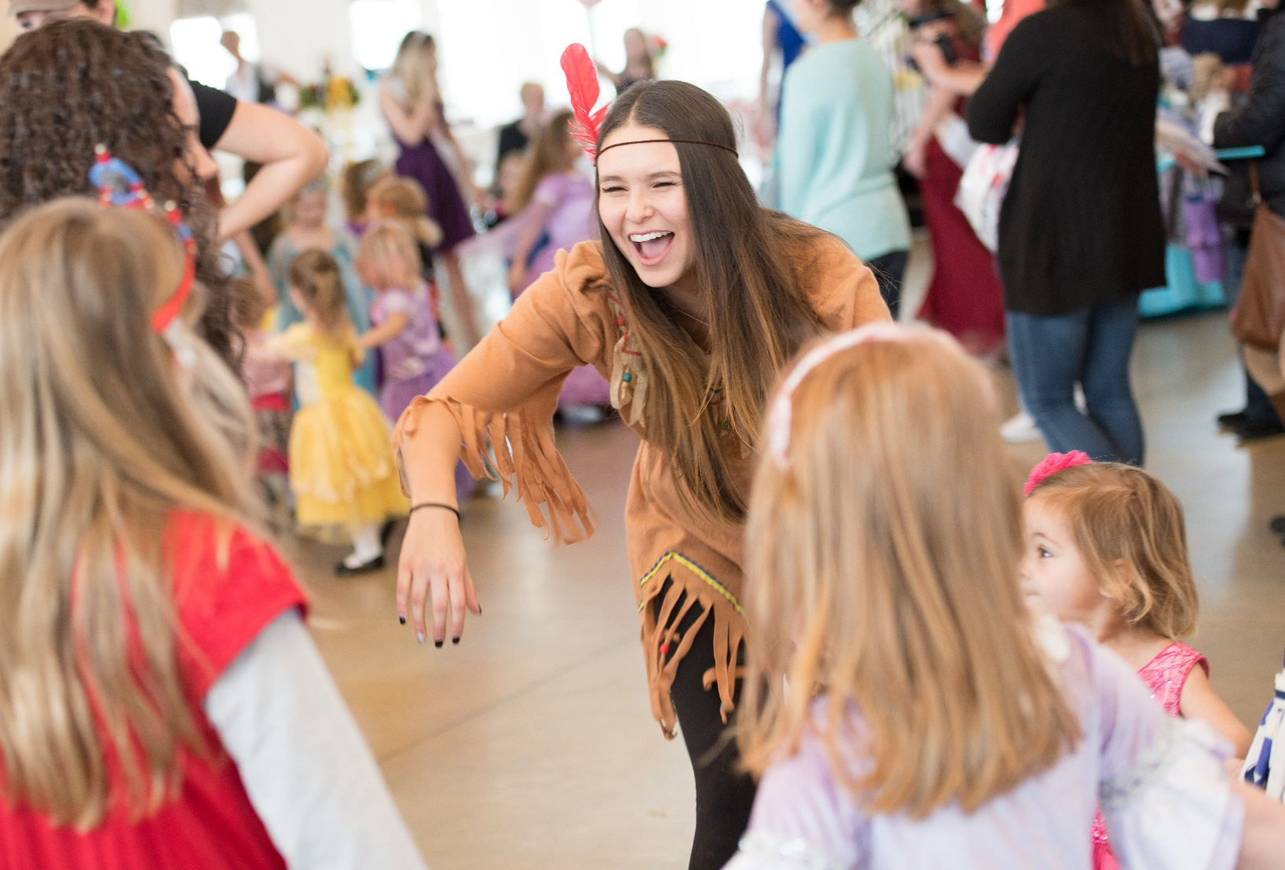
Reflect
a. What worked?
b. What didn’t work?

Slide 10
10 Biggest Mistakes in Event Planning
1. Failure to Set a Goal
With financial goals break them down by the source of the revenue: ticket sales, sponsorships, auction proceeds, raffle, paddle up, wine pull, and any other fundraising activity you offer.
2. Failure to Create a Schedule
3. Overlooking Competing Events- check community calendars!!!
4. Not Enough Volunteers
5. Under Trained Volunteers
Volunteers come with the best of intentions, and you couldn’t do it without them. Help them do their best and help yourself by giving them very specific instructions for the task you are asking them to perform.
6. Poor Ticketing Process – if it is difficult people won’t buy them

Slide 11
10 Biggest Mistakes in Event Planning
7. Poor Registration Process
You need to get people in fast so they can enjoy the event! You don’t want the biggest thing that they remember is how long it took for them to get registered at your Fundraiser!
8. No Contingency Plan – bad things happen so tap into your inner pessimist and see what else you can come up with to plan for
9. No Packing List
a. Need to have a list of all of the most important things you need for your Fundraiser but you also need a list of all the things you might need
This list includes things like sharp scissors, Scotch tape, duct tape, packing tape, extra markers, notebook, a mini stapler, a mini sewing kit, a calculator, aspirin or other pain reliever, paper towels, self-stick labels, a measuring tape, a couple of screwdrivers, a stain remover stick, and Superglue.
10. Failing to Focus on The Little Things – these are the things people remember

Slide 12
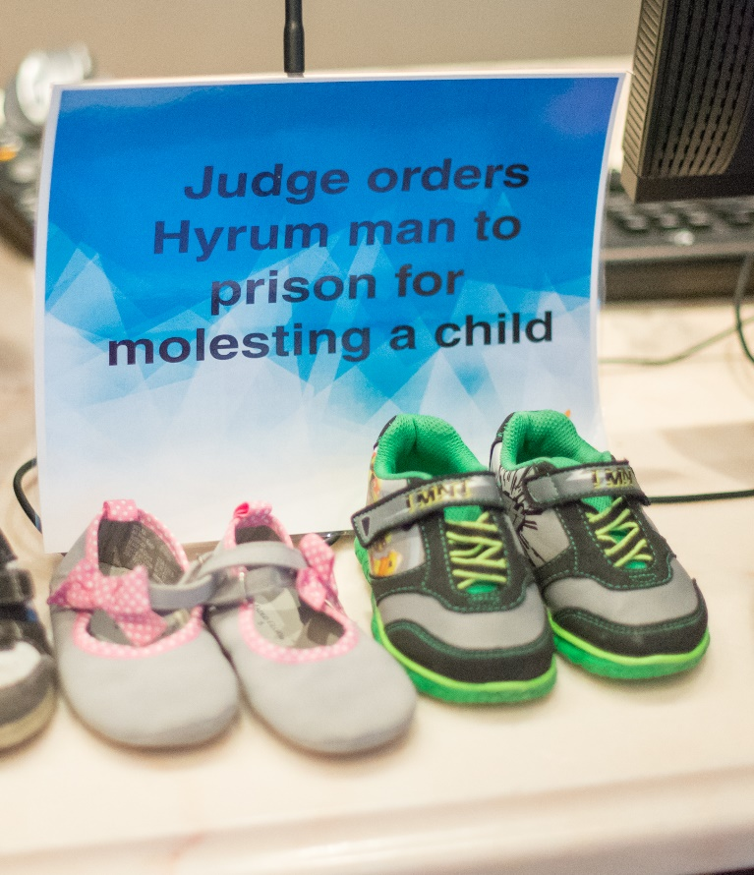
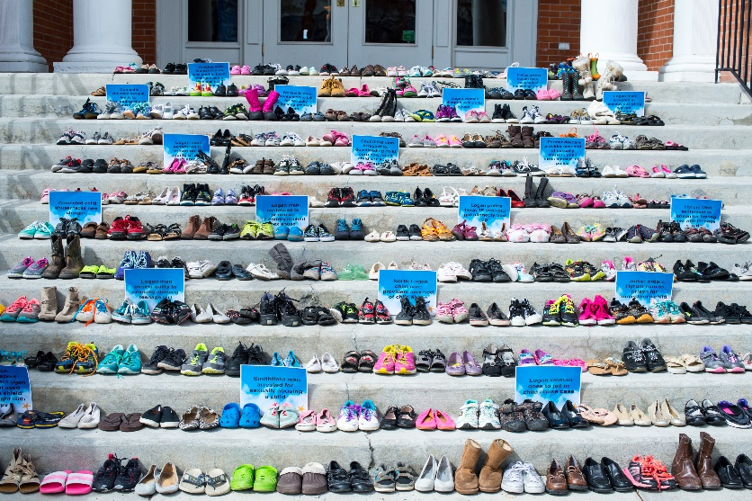
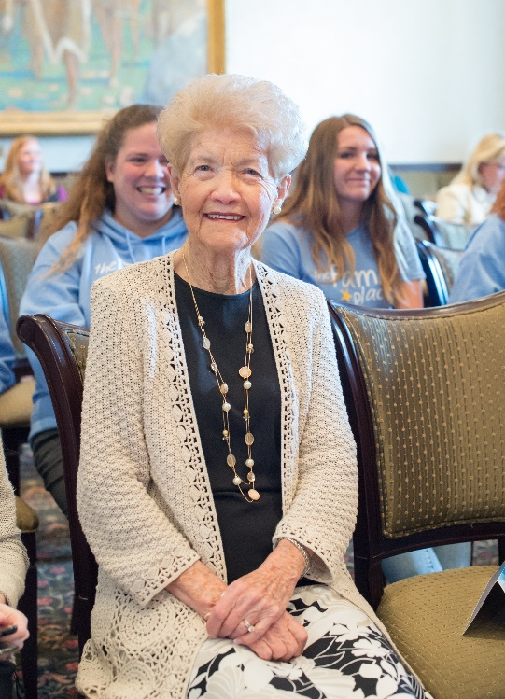
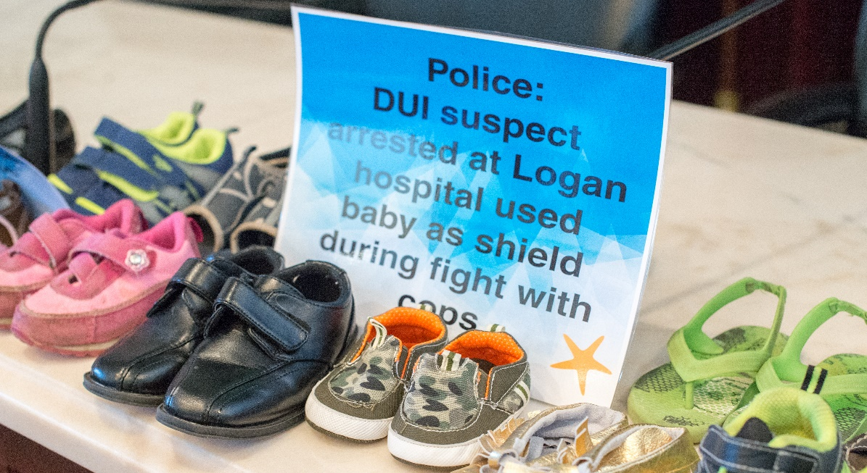
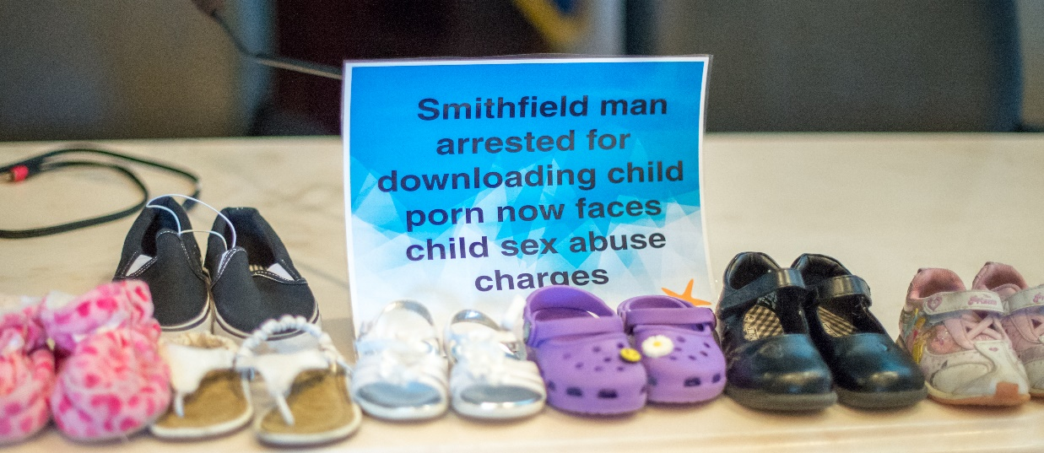
Remember the WHY

